Slide 1
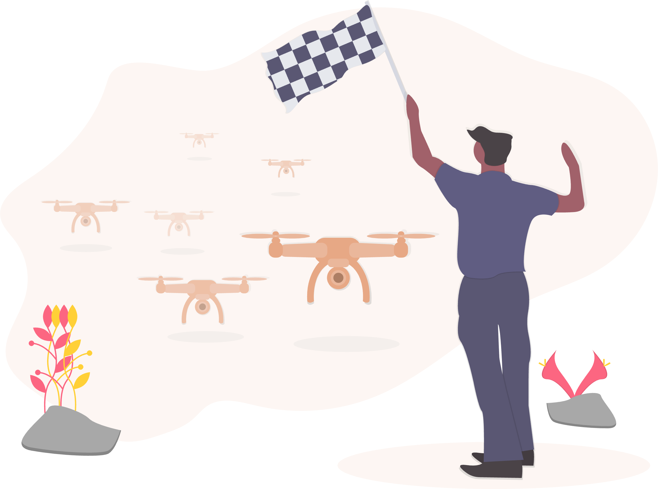
RUINS TO RECOVERY: MACHINE LEARNING FOR DISASTER BUILDING DETECTION
Ruthik Kale (GRA – ITOS)

Slide 2


01
INTRODUCTION

Slide 3
Introduction
Rapid and accurate building detection is critical for effective disaster response and resource allocation.
Existing methods are often overwhelmed by the scale and urgency of post-disaster needs.
This project introduces machine learning solutions, specifically tailored to enhance speed and accuracy in building detection under disaster conditions.

Slide 4

02
BACKGROUND & RELATED WORK

Slide 5
Background & Related Work
Conventional building detection methods are manual and slow, struggling to meet the demands of timely disaster response.
Recent advancements in CNNs have shown promise in remote sensing but are underutilized in disaster scenarios.
Our study builds on existing knowledge and introduces machine learning architectures tailored for post-disaster building detection.

Slide 6

03
METHODOLOGY OVERVIEW

Slide 7
Data Preparation
Model Evaluation
Data Collection
Model Training
Results

Slide 8

04
DATA PREPARATION

Slide 9
Data Preparation
High-resolution satellite images are segmented into 1024x1024 pixel chunks using rasterio and PIL, optimized for efficient processing.
GeoPandas is employed to create precise building masks from shapefiles, essential for accurate model training.
Images and masks are converted into TensorFlow-compatible TFRecord files, enhancing the model's training efficiency.

Slide 10
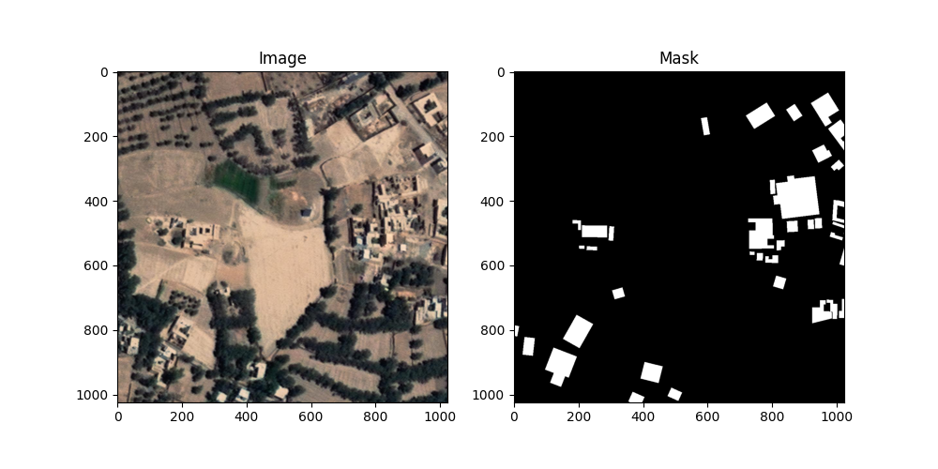

Slide 11
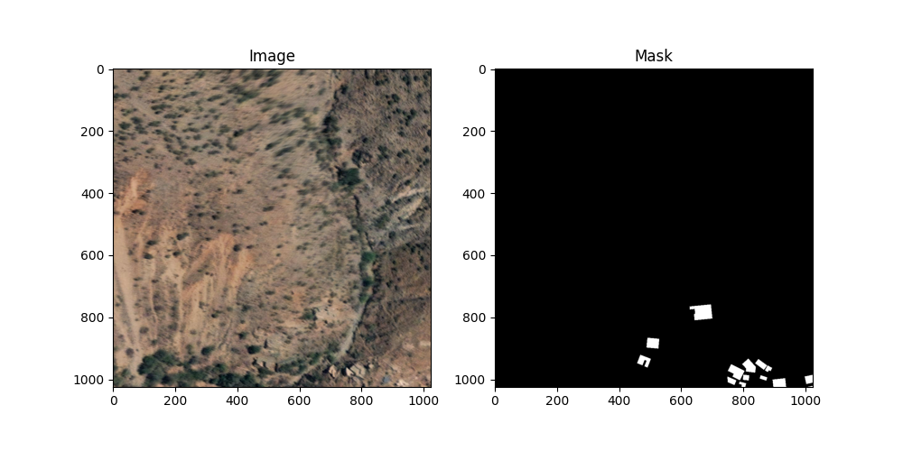

Slide 12
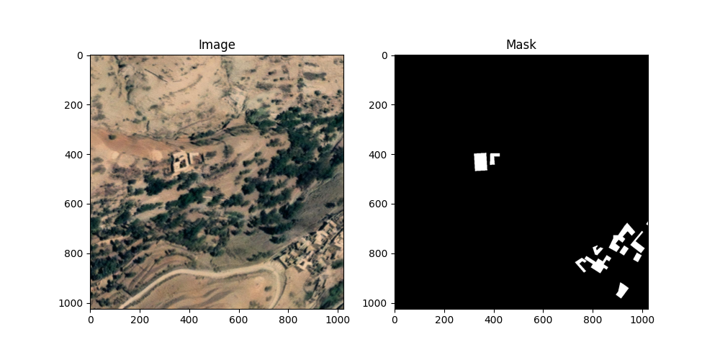

Slide 13
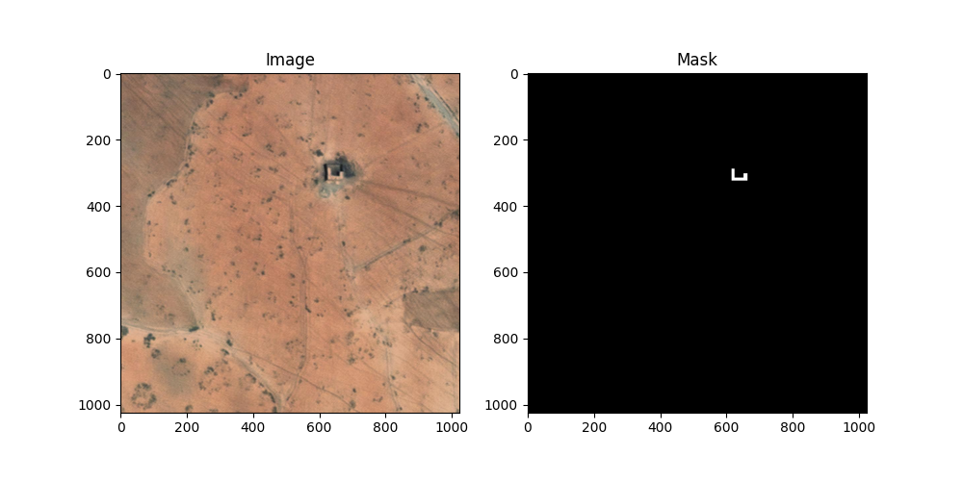

Slide 14
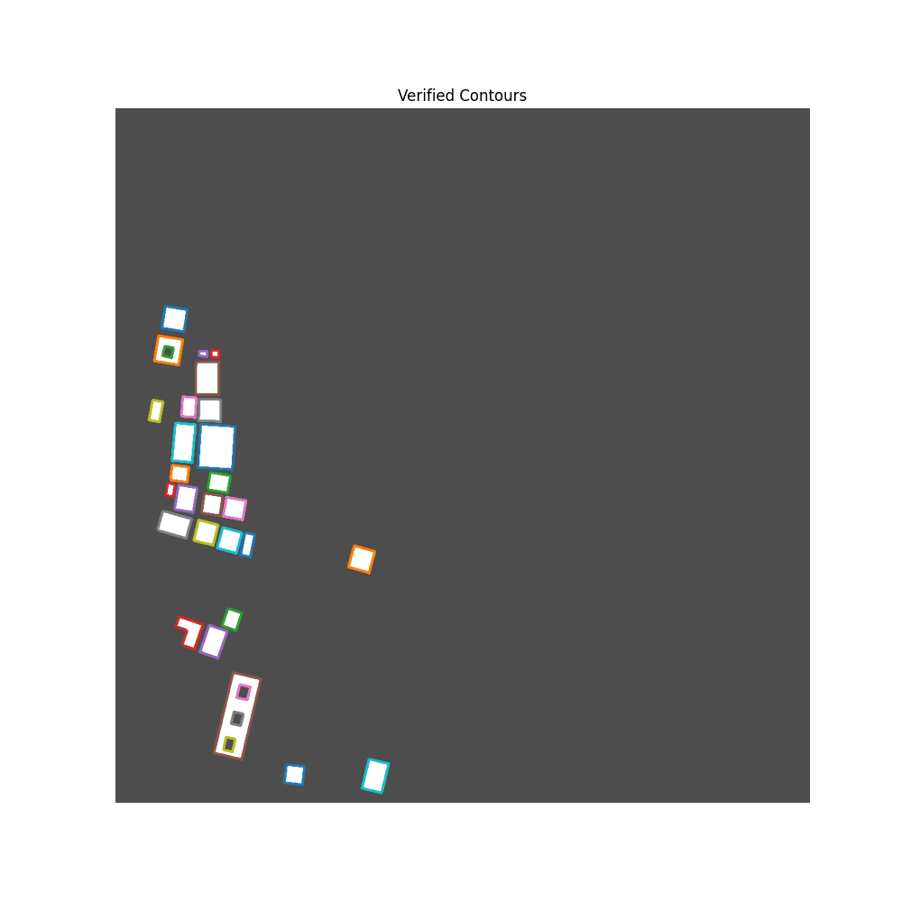

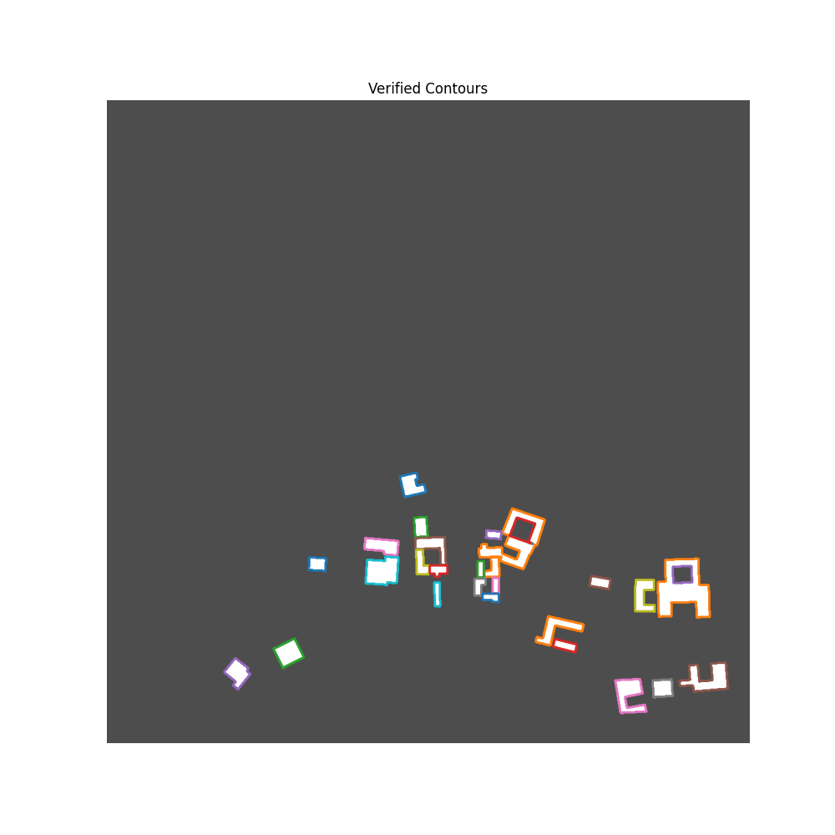
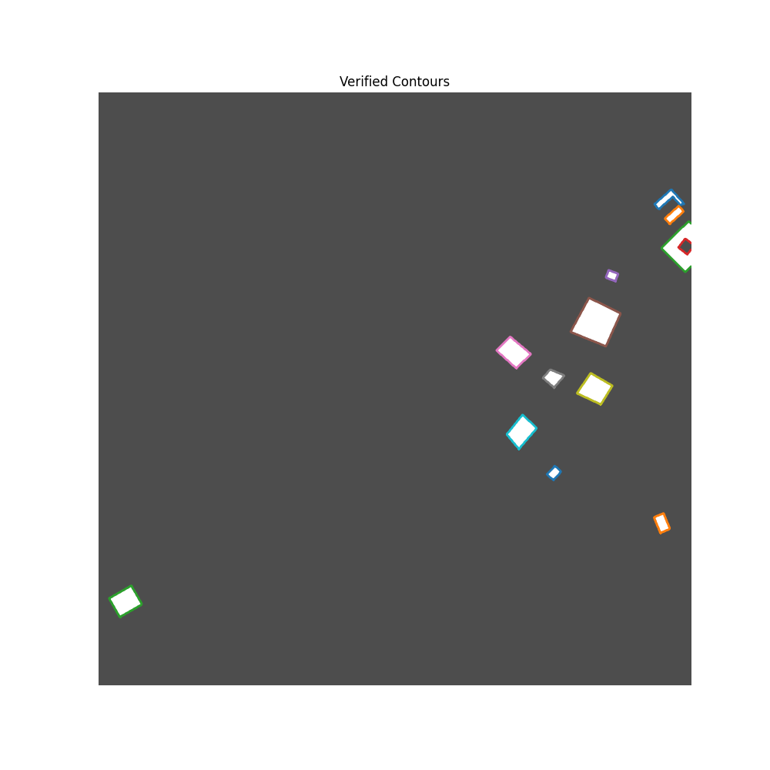

Slide 15

05
MODEL TRAINING

Slide 16
Model Training
The Mask R-CNN Inception ResNet V2 1024x1024 model is trained using NVIDIA A100 GPUs, enabling high-speed computations.
Extensive testing of various hyperparameters, such as learning rates and batch sizes, is conducted to find the optimal model settings.
Training is performed on Sapelo2's high-performance computing resources, allowing for robust model development.

Slide 17
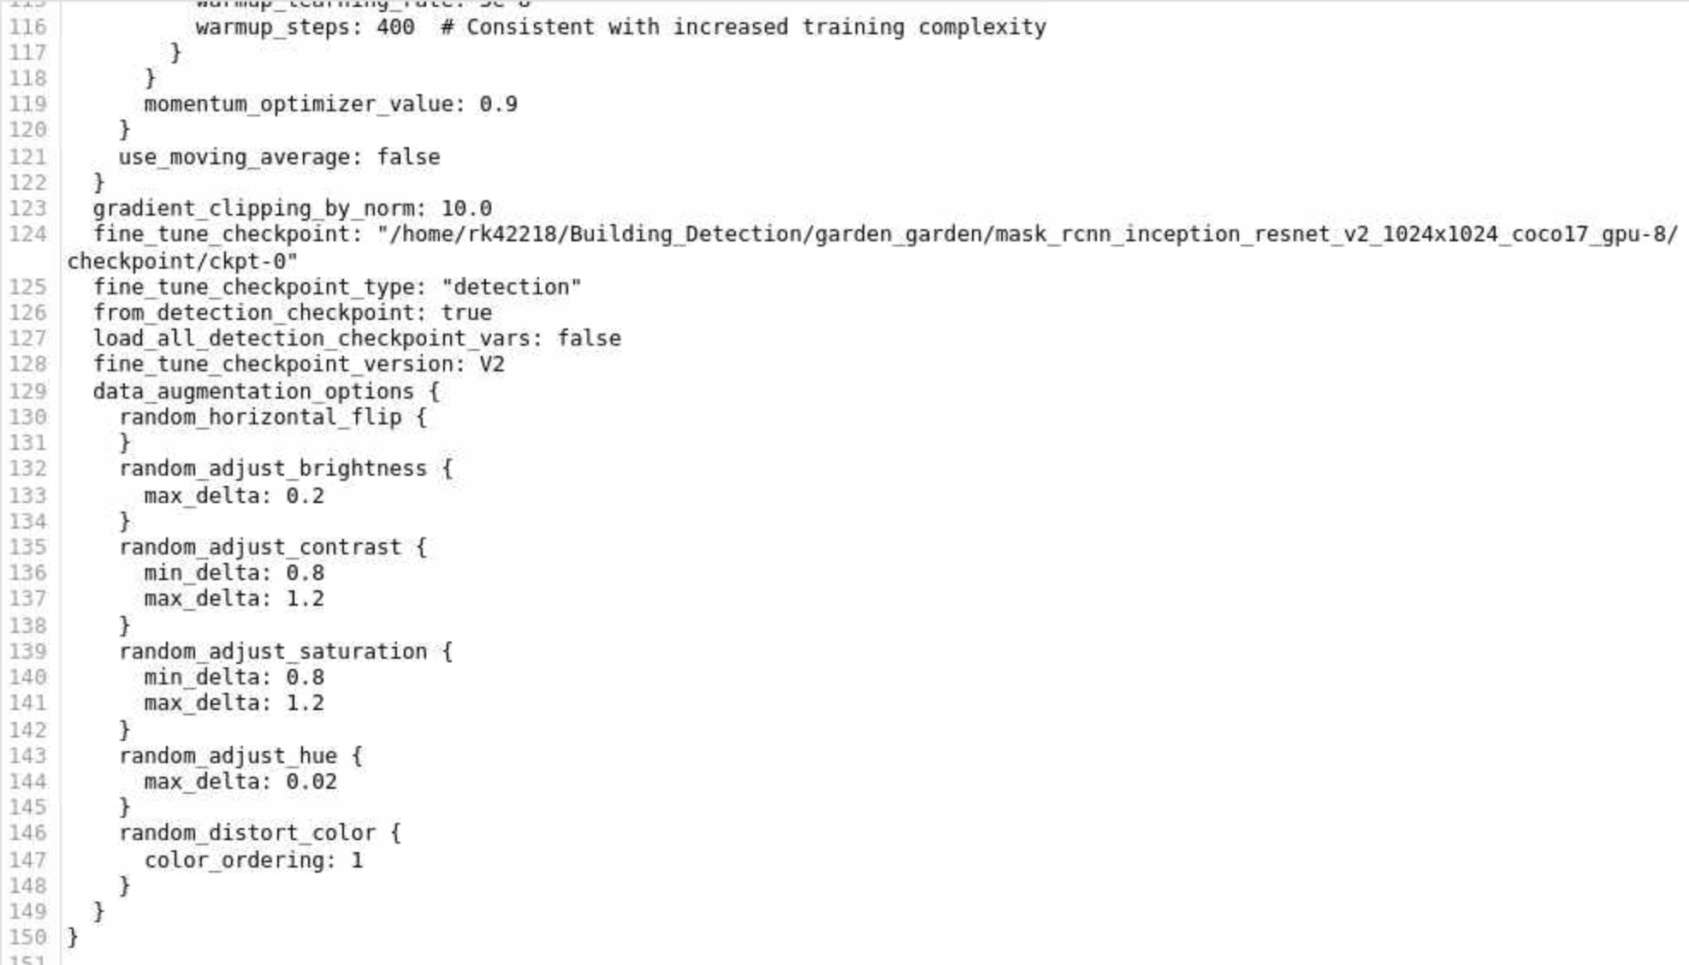
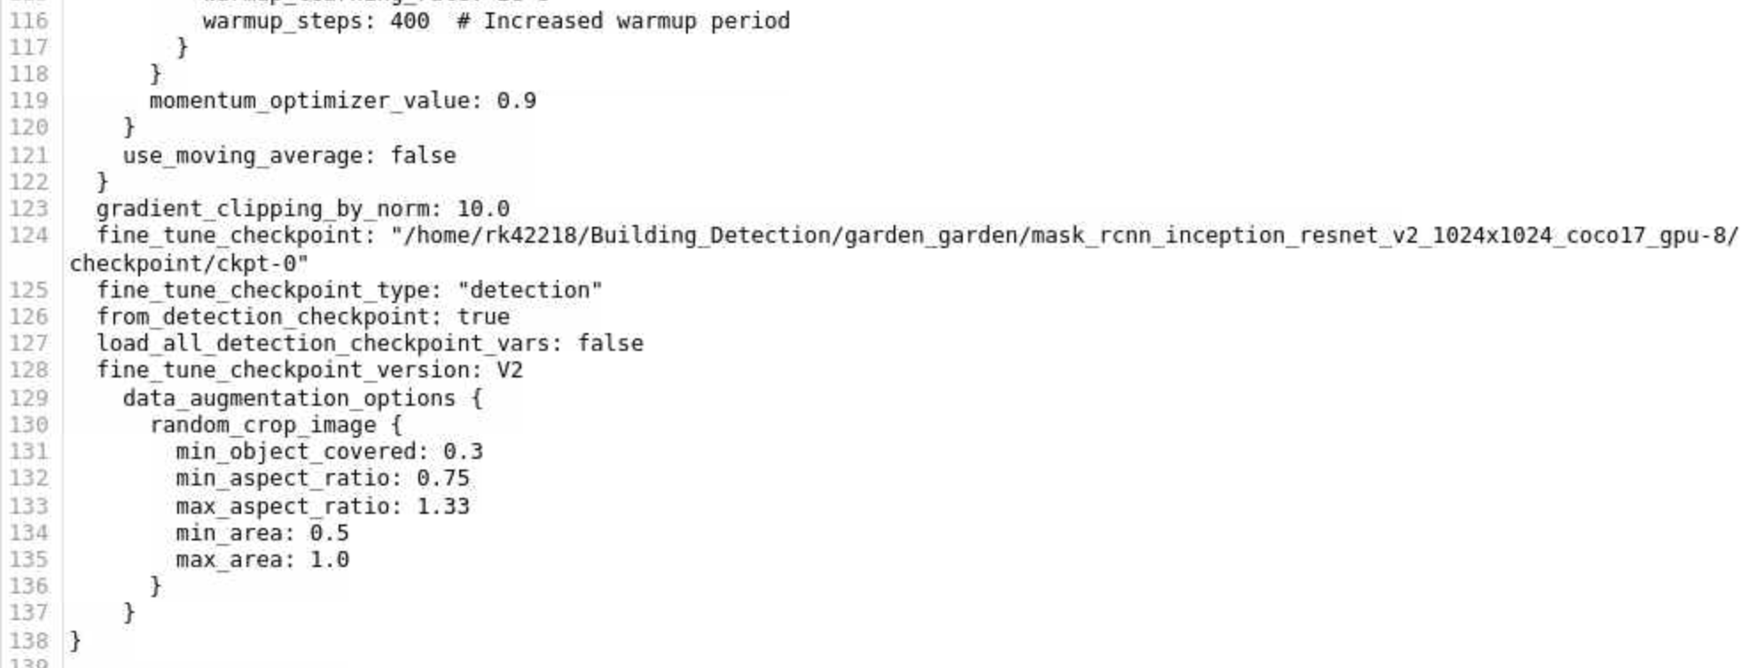

Slide 18

06
MODEL EVALUATION

Slide 19
Model Evaluation
Model performance is assessed using precision, recall, and Intersection over Union (IoU) metrics.
These metrics provide critical insights into the model's ability to identify and accurately delineate buildings from satellite imagery.

Slide 20
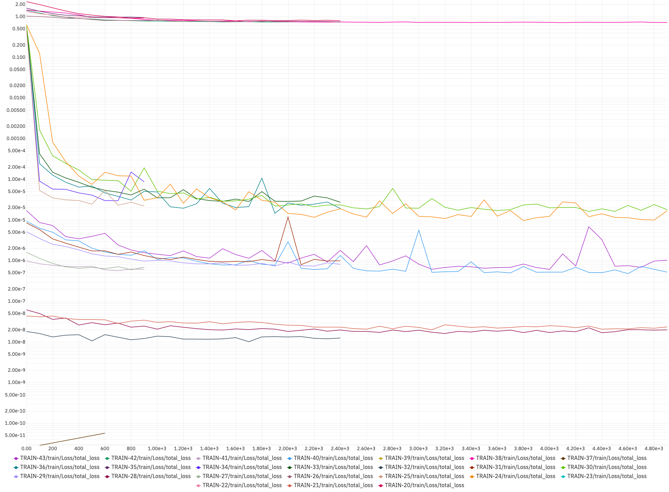
TOTAL
LOSS

Slide 21
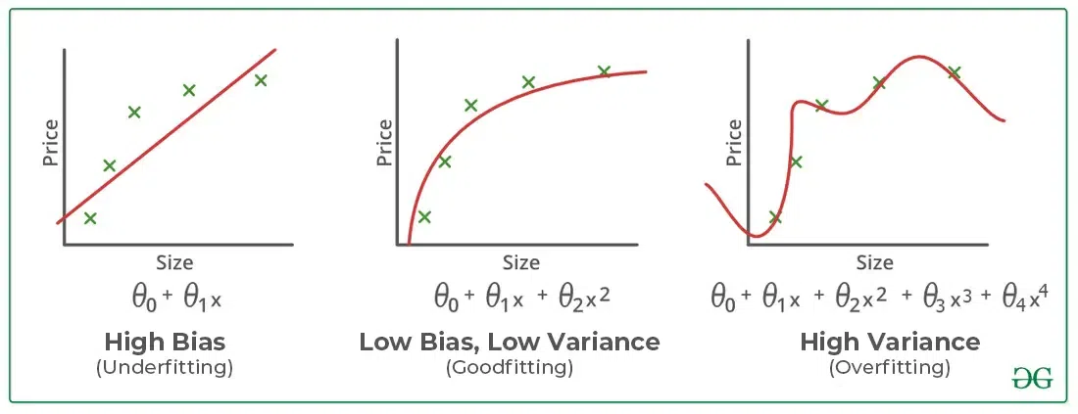
TOTAL
LOSS
https://www.geeksforgeeks.org/underfitting-and-overfitting-in-machine-learning/

Slide 22
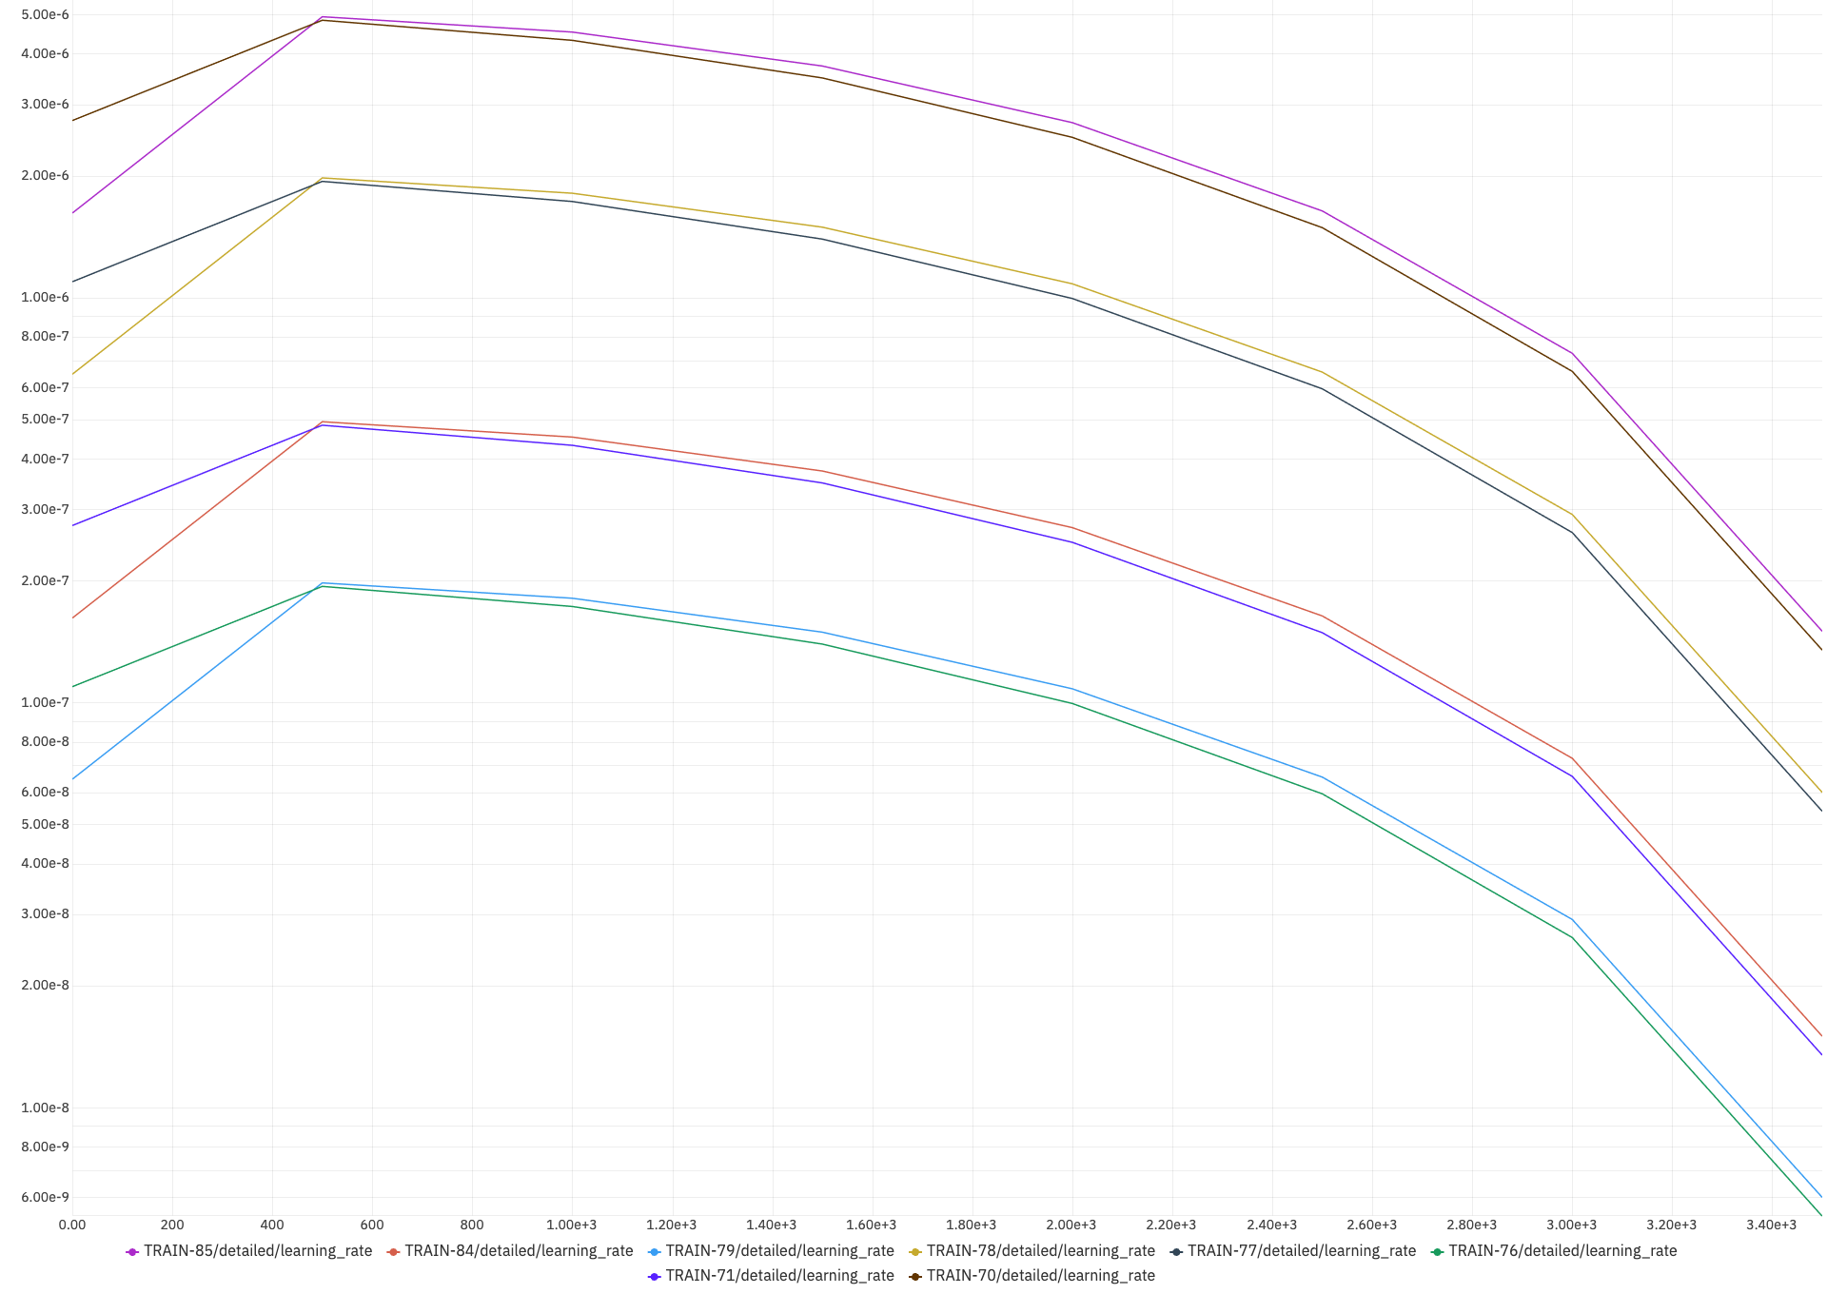
LEARNING
RATE

Slide 23
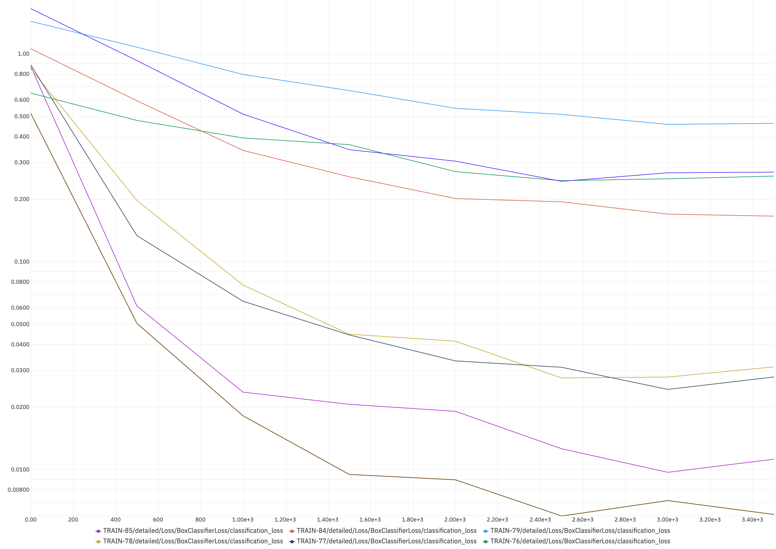
CLASSIFICATION
LOSS

Slide 24
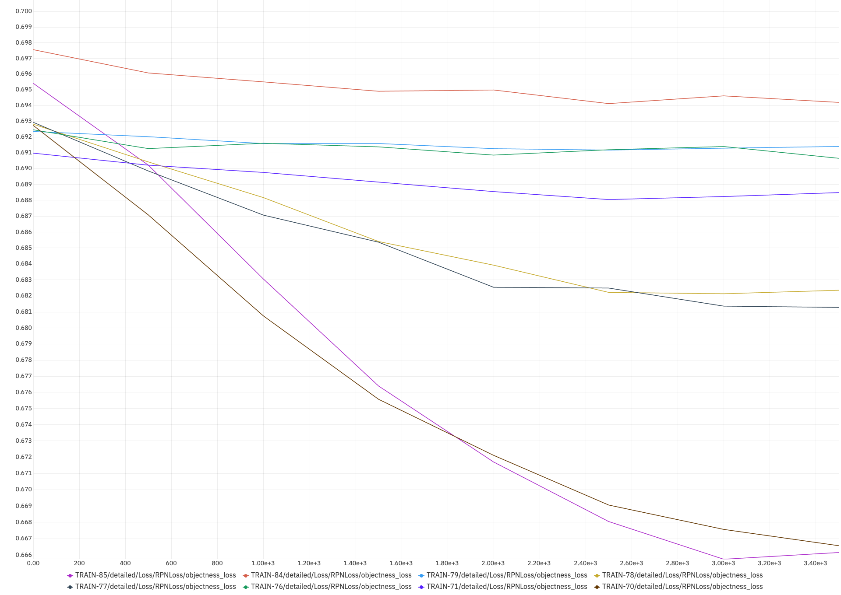
OBJECTNESS
LOSS

Slide 25
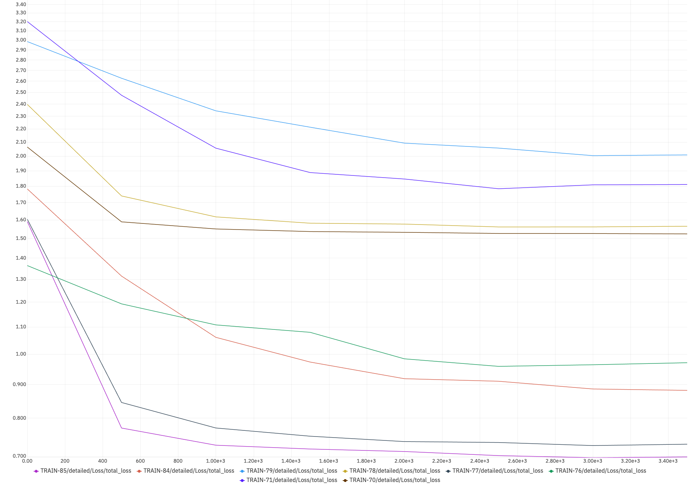
TOTAL
LOSS

Slide 26
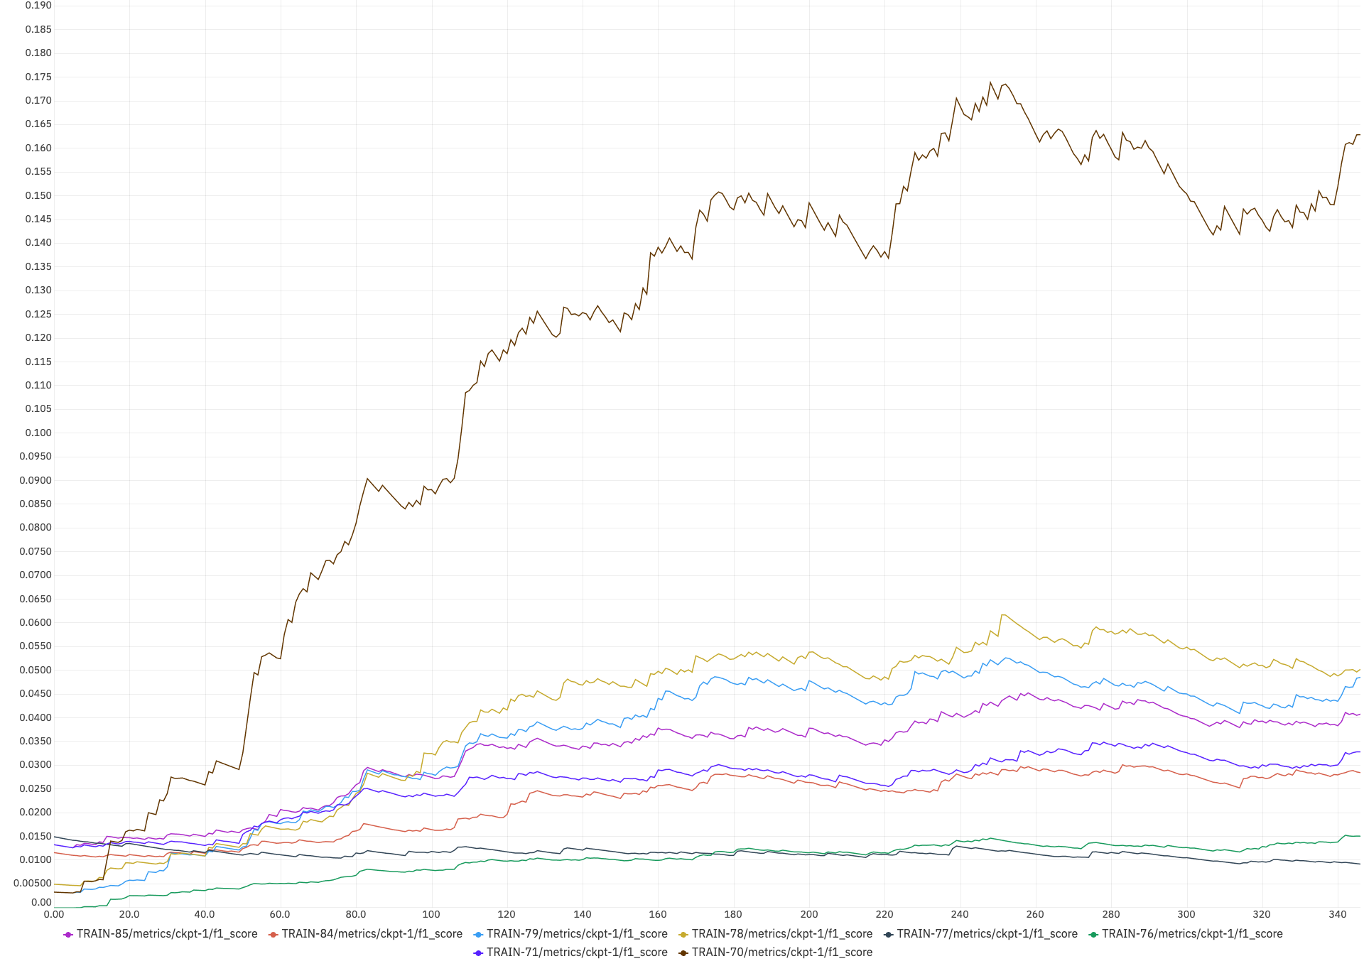
F1
SCORE

Slide 27
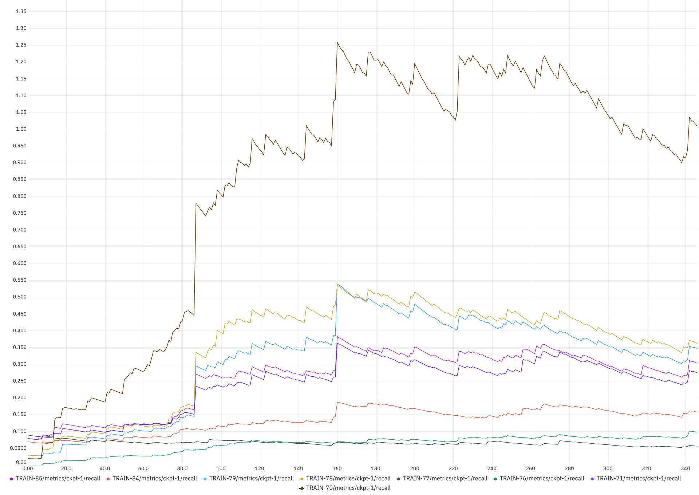
RECALL

Slide 28
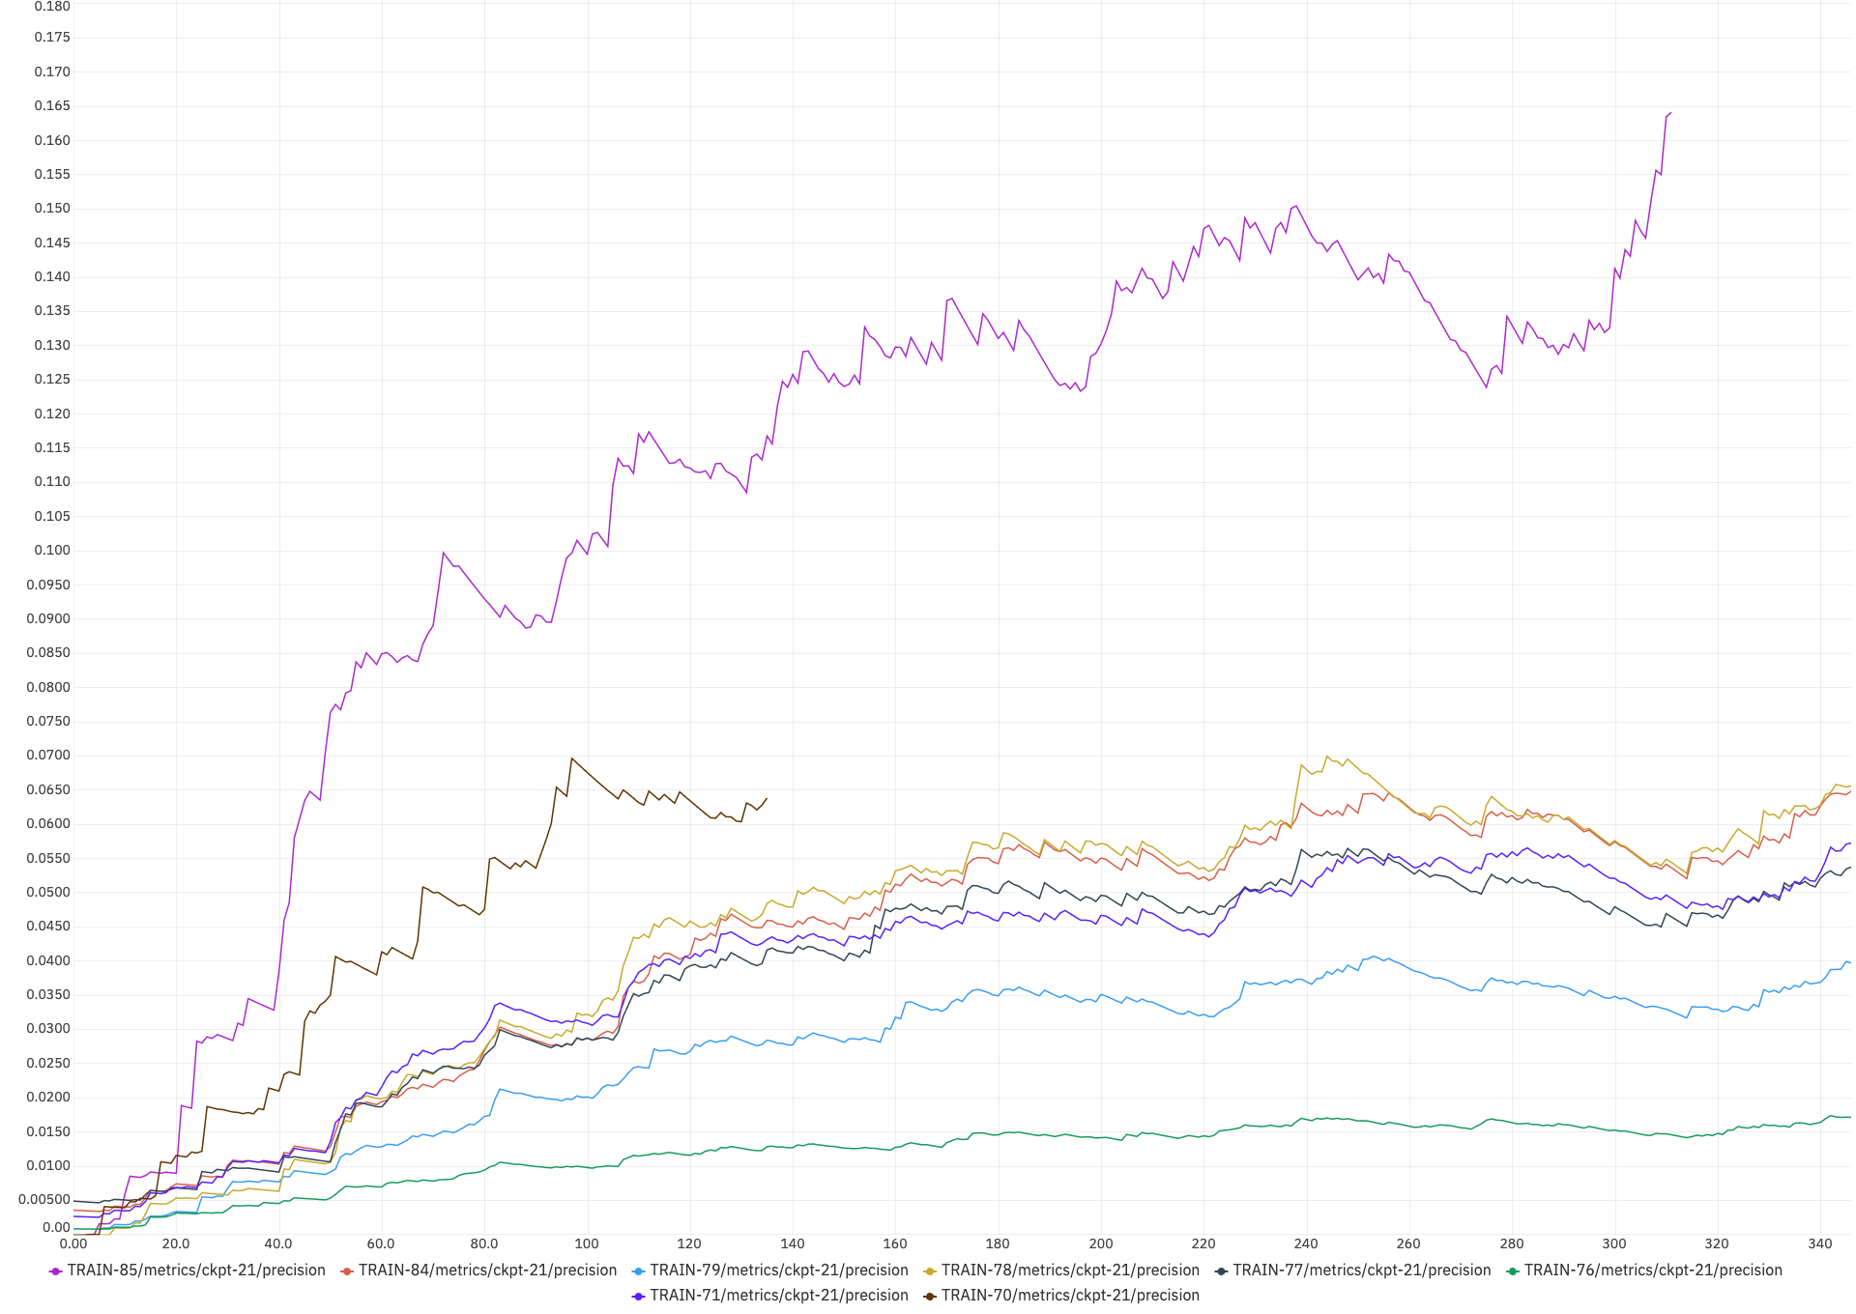
PRECISION

Slide 29
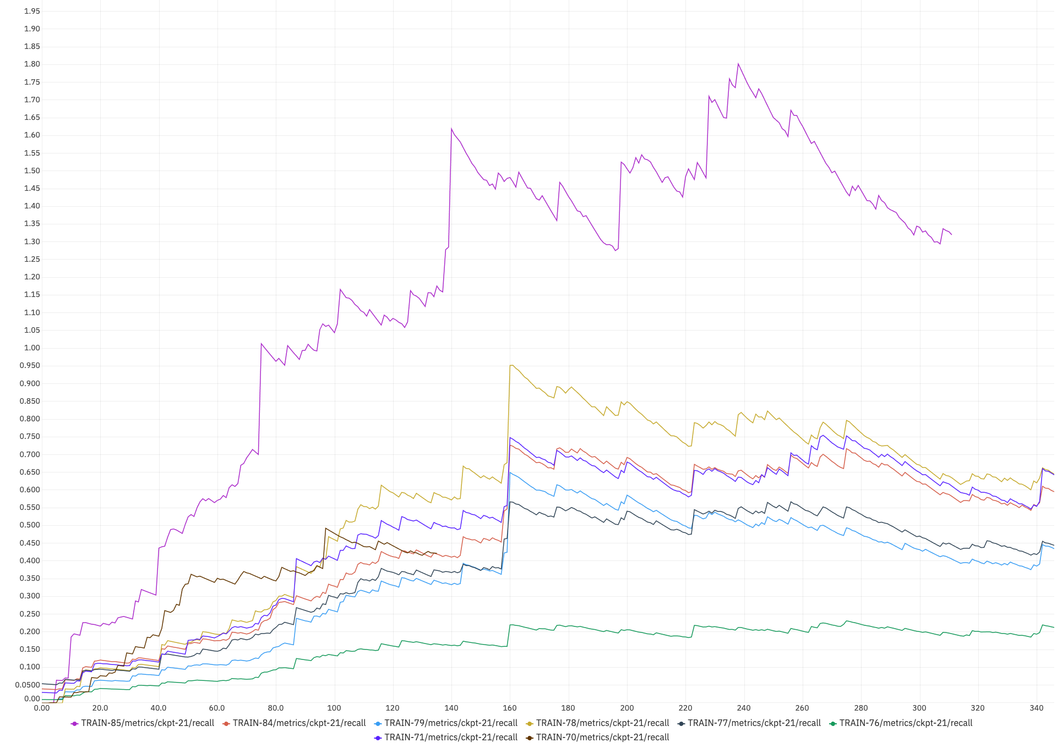
RECALL

Slide 30

07
EXPERIMENTS & RESULTS

Slide 31
Experiments & Results
The evaluation phase involves rigorous testing across different model configurations and extensive data sets.
Results show that our machine learning model significantly outperforms traditional methods, demonstrating high levels of precision and recall.
Detailed analysis of performance metrics is facilitated by Neptune, which tracks each iteration of model training.

Slide 32
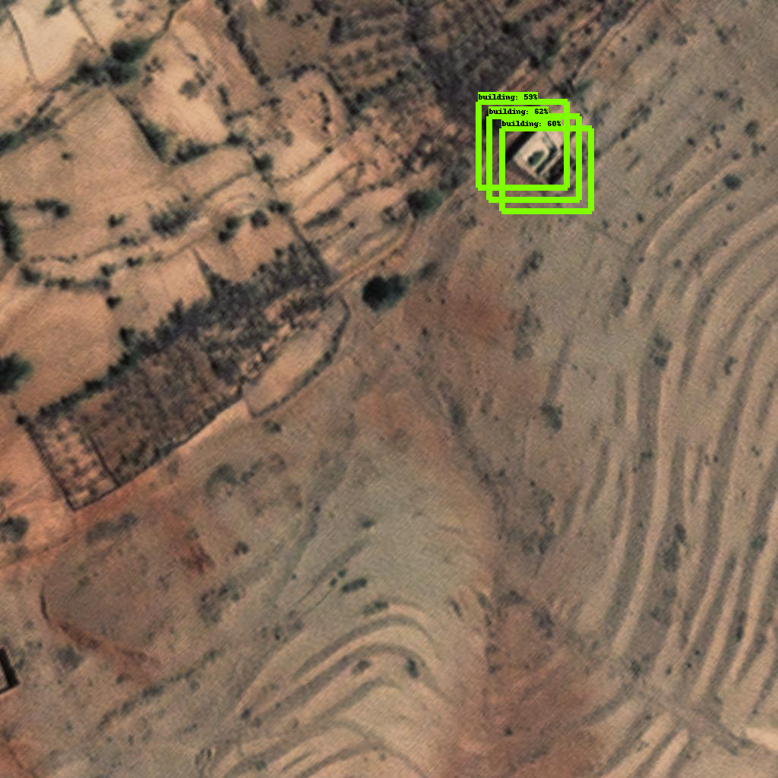

Slide 33
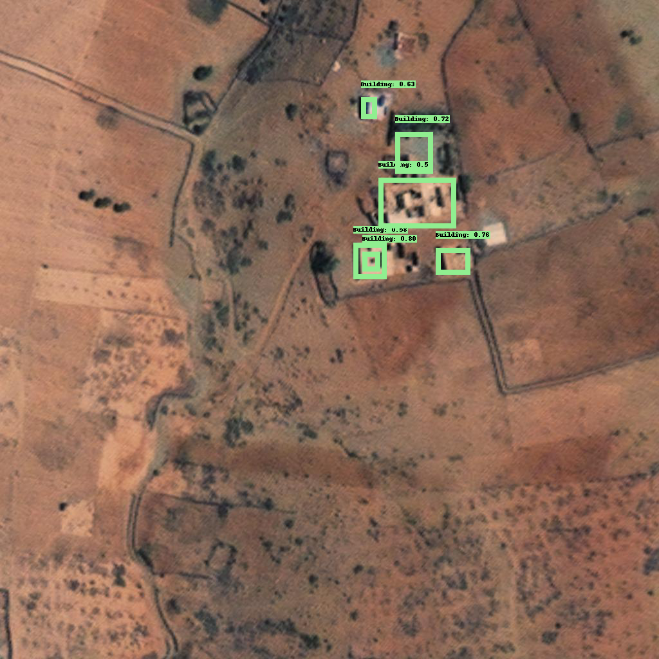

Slide 34
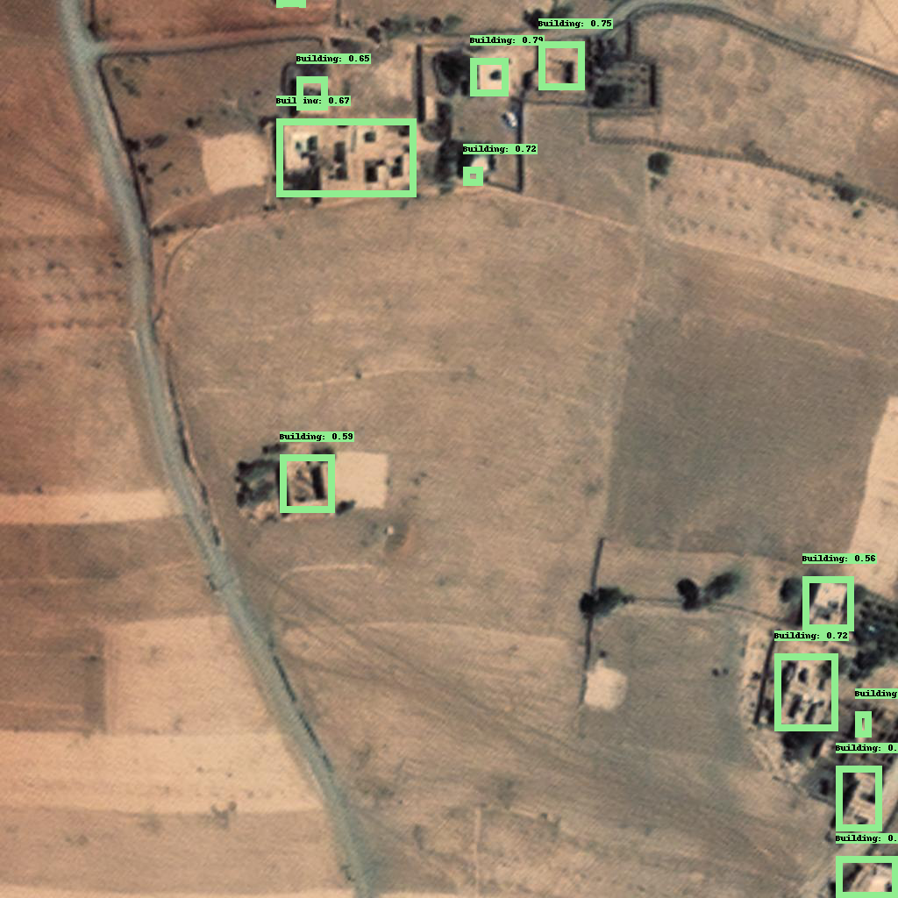

Slide 35
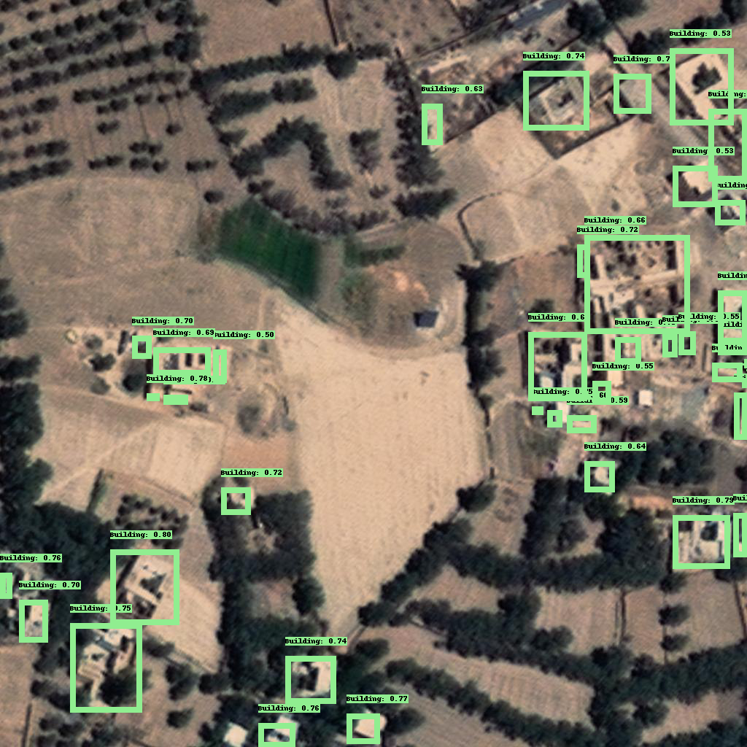

Slide 36
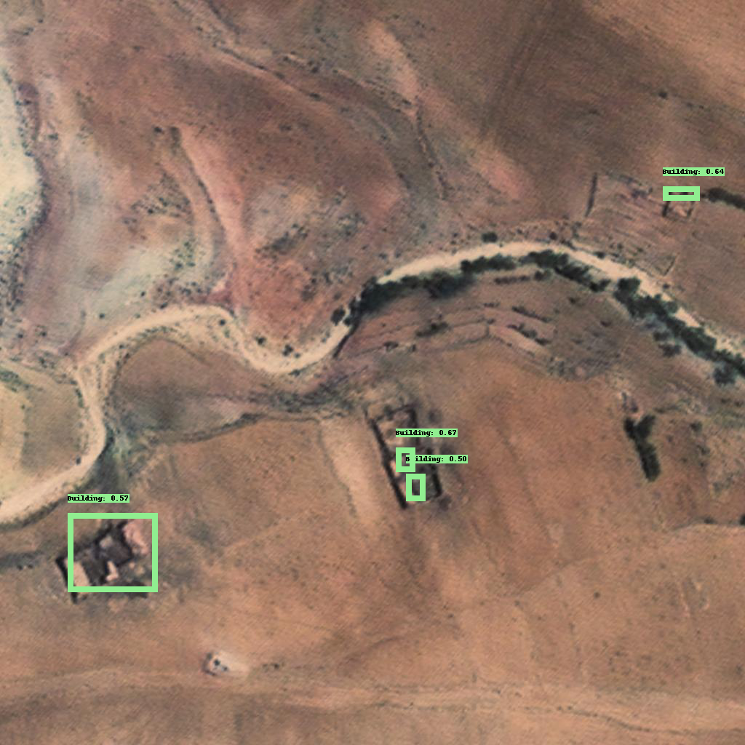

Slide 37
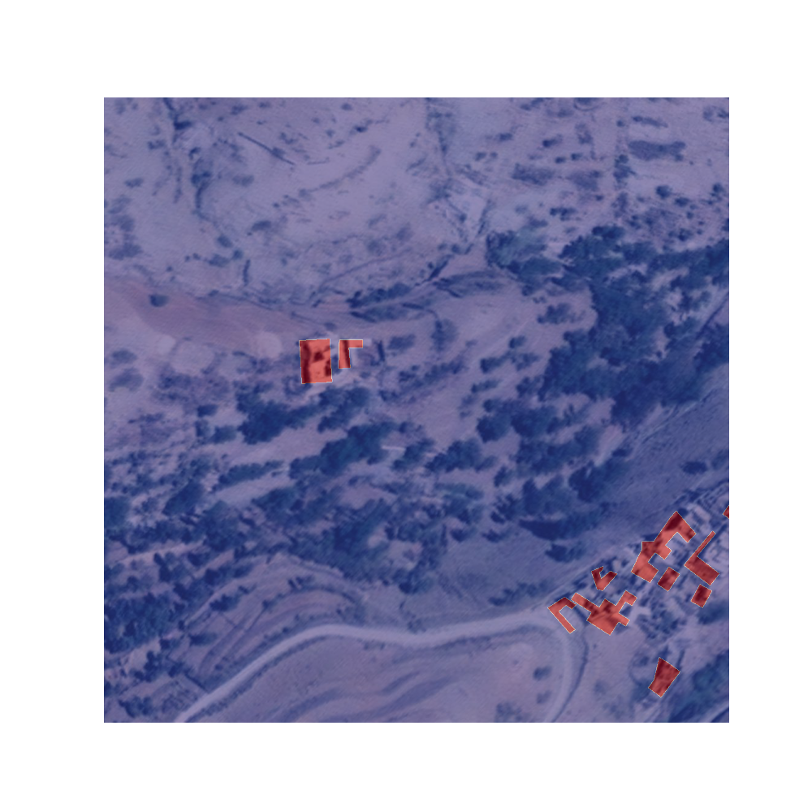
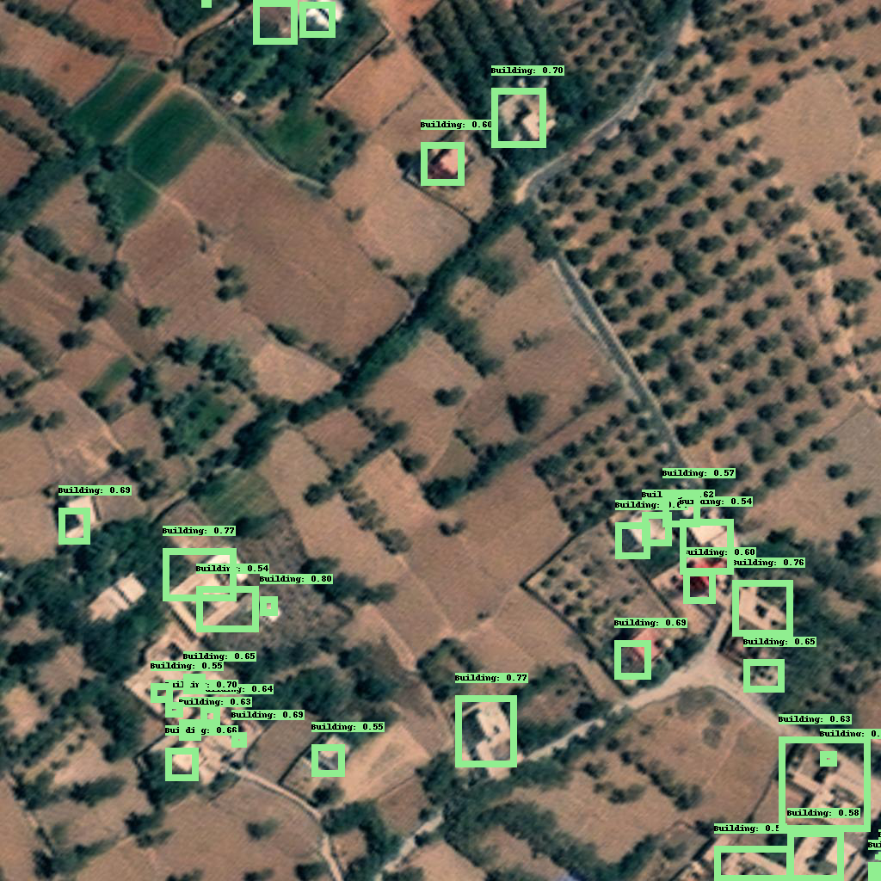

Slide 39

08
CONCLUSION & FUTURE WORK

Slide 40

Conclusion & Future Work
The project demonstrates the viability of using advanced machine learning techniques to enhance building detection in disaster-stricken areas.
Future improvements will focus on integrating real-time satellite imagery to provide immediate assessments post-disaster.
Plans include expanding the model's scalability to different geographical settings and incorporating continuous learning mechanisms to adapt to new data.

Slide 41

QUESTIONS?

Slide 42

ACKNOWLEDGEMENTS

Slide 43


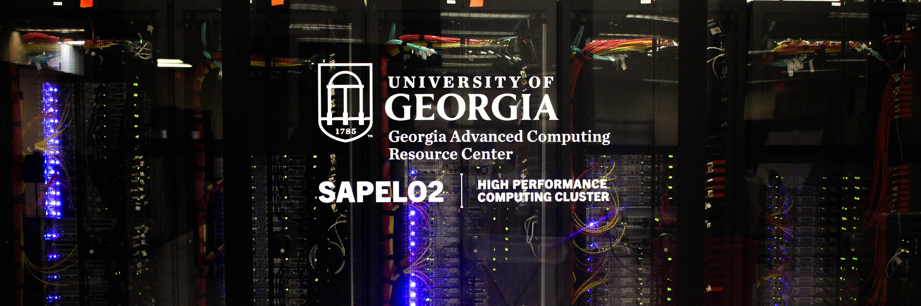

Slide 44
References ☺
xView2
GitHub - DIUx-xView/xView2_baseline: Baseline localization and classification models for the xView 2 challenge.
GitHub - vdurnov/xview2_1st_place_solution: 1st place solution for "xView2: Assess Building Damage" challenge.
https://services5.arcgis.com/0JofV0ocsiMyrWAn/arcgis/rest/services/Morocco_Al_Haouz_Province_West_Structures_and_Buildings_first_edition/FeatureServer
Machine Learning and Disaster Management
Y. Yuan and F. Lin. "Machine learning in visual object recognition: A survey." IEEE Transactions on Neural Networks and Learning Systems, vol. 29, no. 9, pp. 3920-3939, 2018.
Convolutional Neural Networks (CNNs)
A. Krizhevsky, I. Sutskever, and G. E. Hinton. "Imagenet classification with deep convolutional neural networks." Advances in neural information processing systems, 2012.
Remote Sensing and Disaster Response
M. K. Peters, et al. "Remote sensing technologies for enhancing forest inventories: A review." Canadian Journal of Remote Sensing, vol. 42, no. 5, pp. 619-641, 2016.
Mask R-CNN and Its Applications
K. He, G. Gkioxari, P. Dollár, and R. Girshick. "Mask R-CNN." Proceedings of the IEEE international conference on computer vision, 2017.
Use of AI in Post-Disaster Scenarios
L. G. Shapiro and G. C. Stockman. "Computer Vision." Prentice-Hall, Inc., 2001.
Performance Metrics for Object Detection
R. Padilla, S. L. Netto, and E. A. B. da Silva, "A Survey on Performance Metrics for Object-Detection Algorithms," in IEEE Access, vol. 8, pp. 85327-85342, 2020.

